Slide 1
Cloud-Delivered
SD-WAN
October 2017
Matt Berry
VeloCloud Pre-sales Engineer
mattb@velocloud.net

Slide 2
Agenda
Overview
Per Packet Remediation
The VeloCloud Gateway
Security
Hardware Appliance
Virtual Appliance
Use Case: Retail

Slide 3
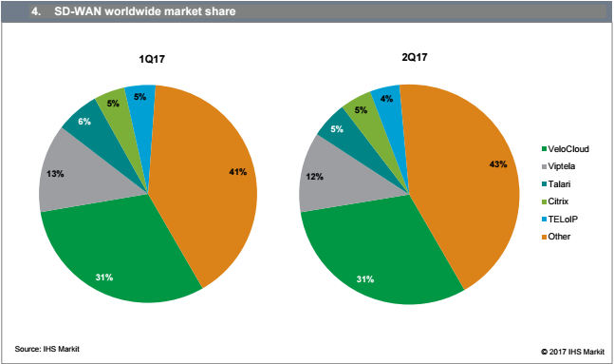
SD-WAN Leaders – Q1 & Q2 2017 Revenues
Notes:
VeloCloud revenue: 31% rev share, $24 million (increased 33 percent from the first quarter 2017)
Viptela: 12% rev. share / $9.2 million in revenue. Last quarter the report had its revenue at $7.7 million, or 13 percent of market share.

Slide 4











THE NETWORK MOVES TO THE CLOUD
The Cloud is the..
Data Center
Application
Storage
Network
Notes:
Our belief is that the Network is the next service to be extended into the Cloud. While some parts of the network infrastructure will continue to reside on premises, the shift to the cloud is real.

Slide 5
Where is IT headed?
Outsourced
IT reduced and focused on core business
Subscription
Not ownership, pay-as-you-go
Distributed
Scalable, available, accessible via Internet

Slide 6
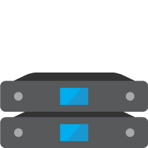
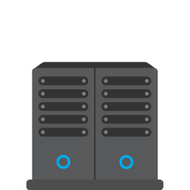



And the Branch Network? Before…
Private Line Is 100X the Cost of Broadband
Deployment Takes Months
Capex of $20K-$50K per Branch
Applications Run Slow
Branch
100s to 1000s
Private Line (MPLS)
Datacenter

Slide 7
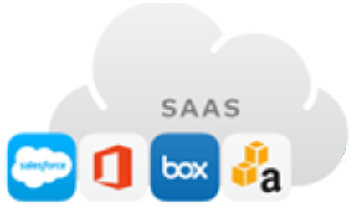
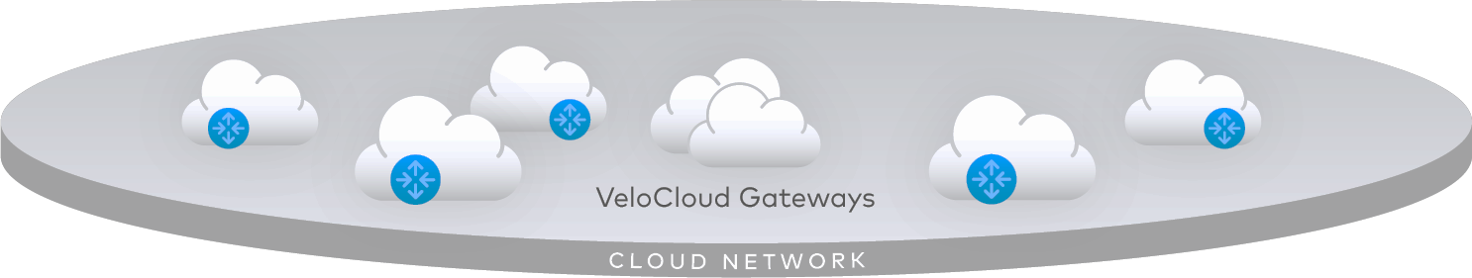
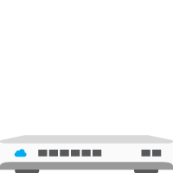

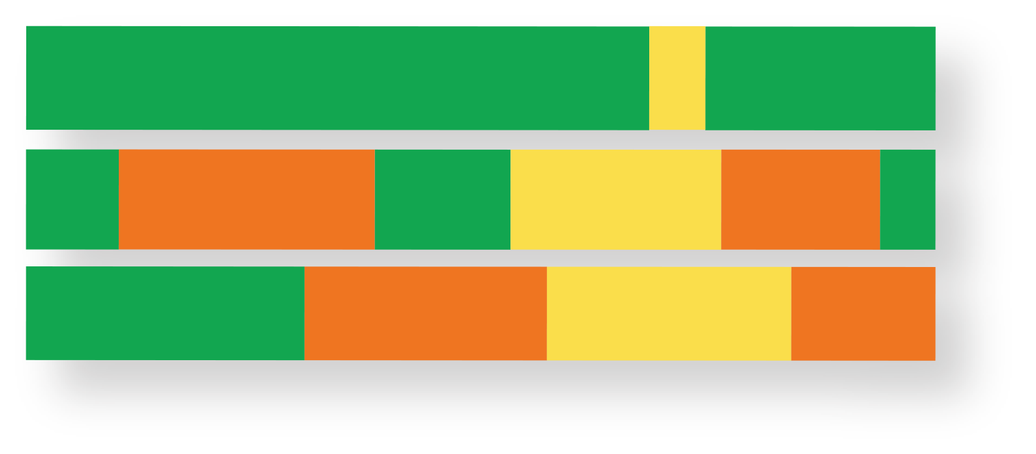
Now… With SD-WAN - the Cloud is the Network
Use Multiple Transports as the WAN
Guarantee Real-Time App Performance
Reduce Capex by 5X; Deploy in Days
Strong Cloud-Based Security
Datacenter
Branch
10s to 1000s
MPLS | Internet | 4G | Any

Slide 8
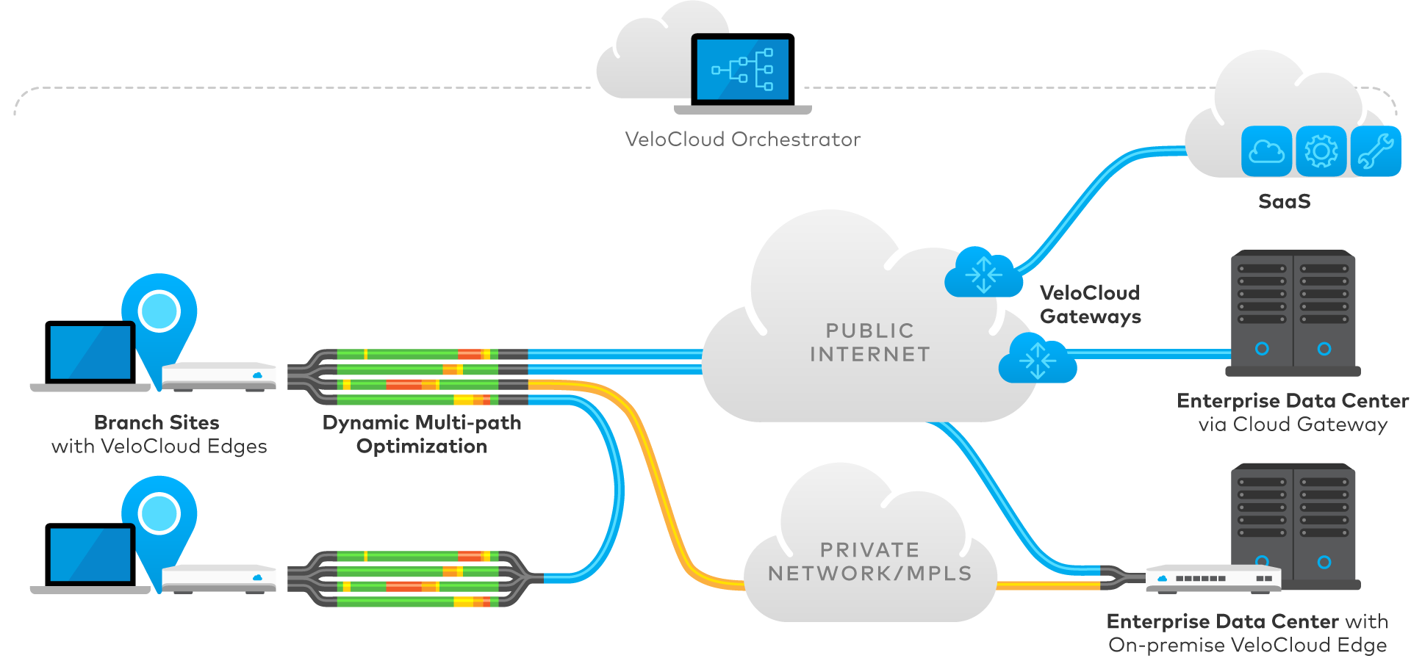
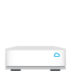

VeloCloud Cloud-Delivered SD-WAN
VeloCloud’s Network Service Consists of 3 Key Components
1
VeloCloud Orchestrator
1
Orchestrator
3
SaaS
2
VeloCloud Gateways
2
Edge
Public Internet
Branch Sites with VeloCloud Edges
Dynamic Multi-Path Optimization
Enterprise Data Center via Cloud Gateway
Private Network/MPLS
3
Cloud Gateway
Enterprise Data Center with On-Premise VeloCloud Edge
Notes:
An overview of our new cloud delivered SD-WAN approach, meeting all the requirements we just outlined.
VeloCloud’s solution consists of three key components:
FIRST is the Edge for zero touch branch deployment.
It can be Fed Ex’ed to a remote location, where a non-IT person can simply plug it into power any variety of circuits
Each branch can leverage one or more circuits using dynamic multi-path optimization
It calls home to the cloud Orchestrator to receive updates, policy and path information
The Edge then connects to multiple gateways throughout the cloud depending on the specific application or destination. Cloud orchestration determines this path selection.
Gateways can provide direct access to SaaS, but with overlay optimization and security
as well as access to enterprise datacenters, without any DC installation.
Finally, optimal branch to branch is supported via DISTRIBUTED CLOUD GATEWAYs eliminating hub-spoke backhaul.

Slide 9
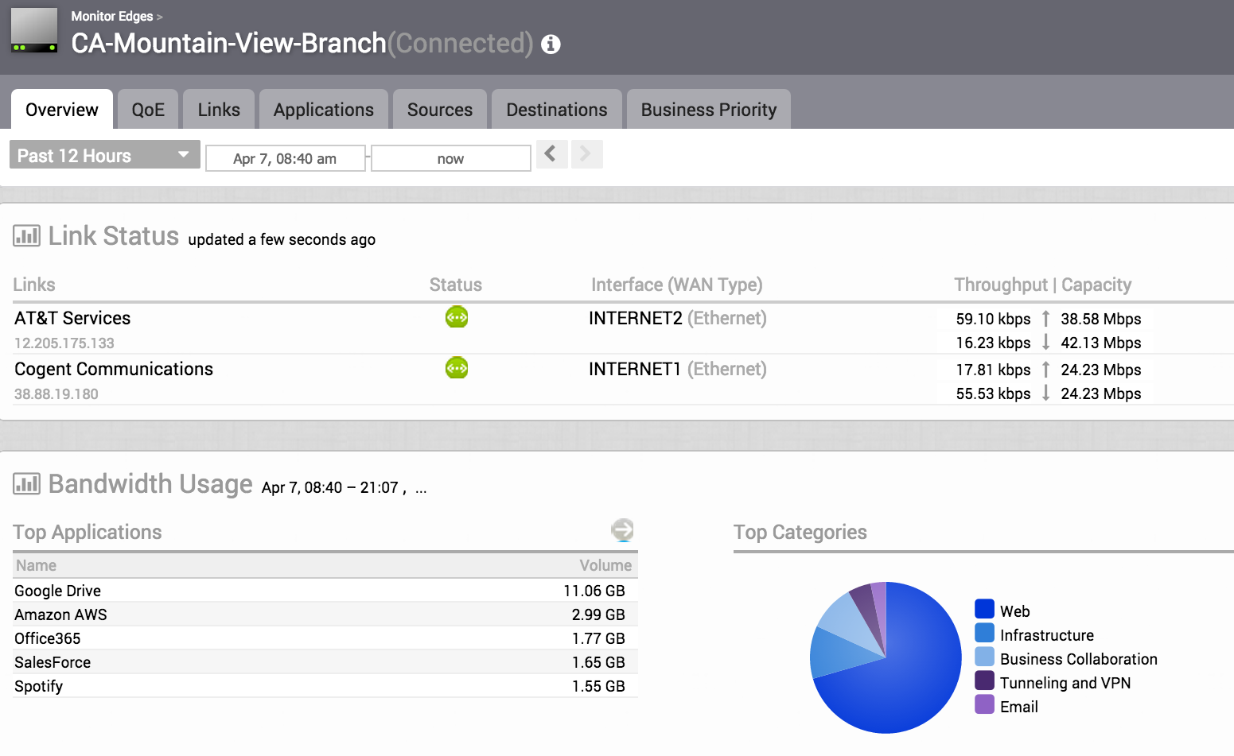
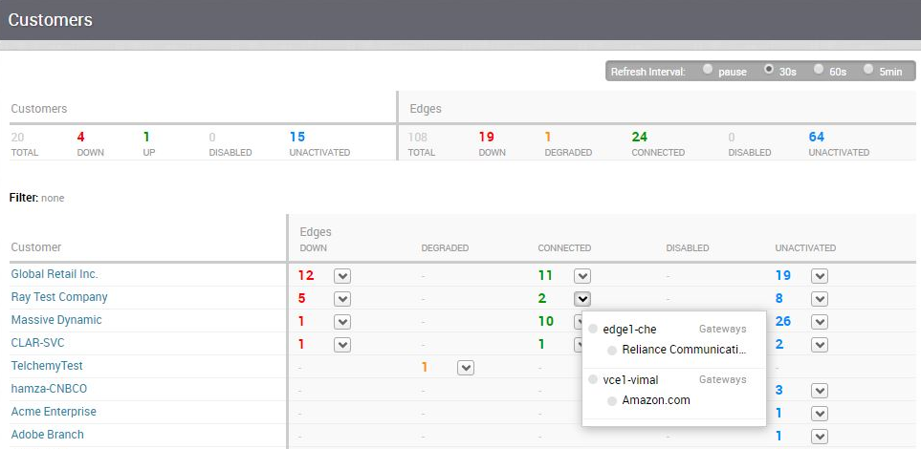
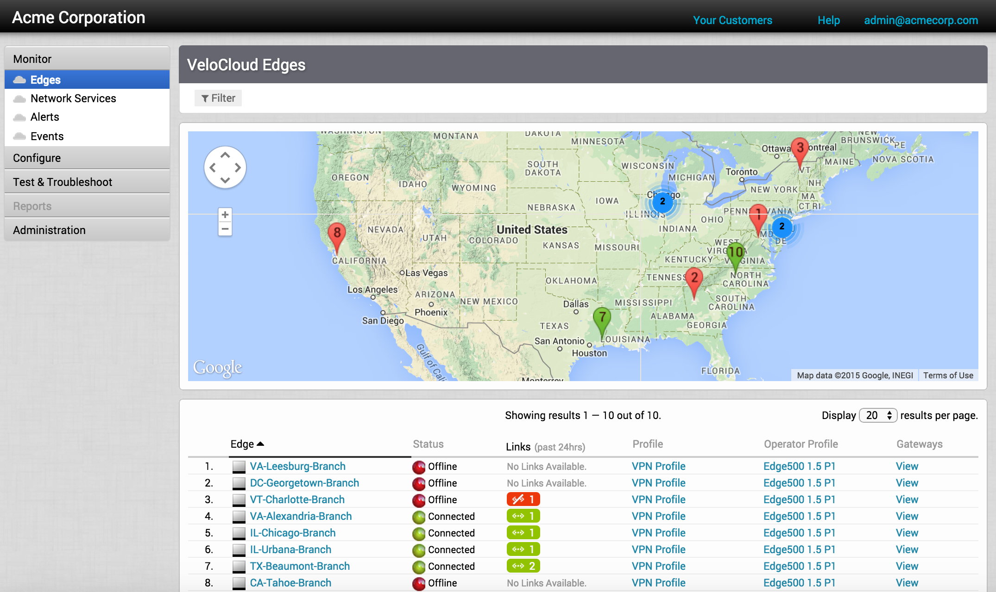
All-in-One SD-WAN Orchestration
CLI
Zero touch provisioning
Group business level policies
Automatic link profiling
Notes:
Our flexibility also is supported by our existing offering
Of our SDWAN in a Virtual Edge as a VNF, with the APIs and SDKs for integration into our partners virtual CPEs.
ATT with their Flexware solution is a leading example of this. Additionally from our security ecosystem partners, Fortinet will also add our SDWAN VNF option to their FortiHypervisor [ now ]

Slide 10
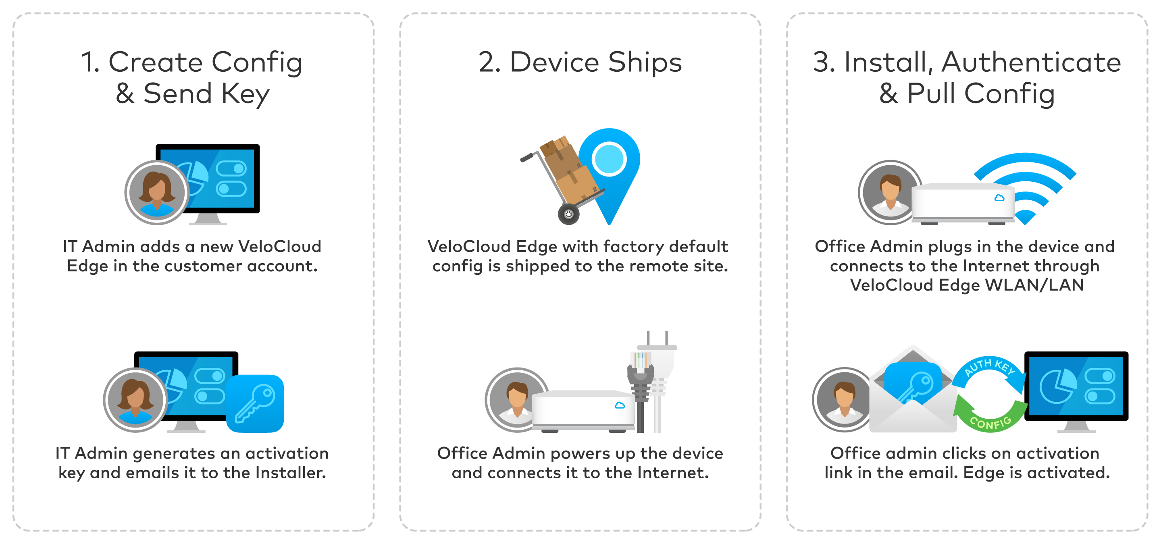
One Touch Provisioning
Notes:
A key benefit of our SDWAN Edges is simple yet secure activation.
Today we have something you should be familiar with called pull activation
A simple email to the installer provides the trust, direction to right Orchestrator, and specific profile, including if needed the static IPs to establish connectivity.
But requires knowing who to send the email to.
We are adding an additional option, PUSH ACTIVATION, in 3Q for providers and 4Q for Enterprises
It has all the same benefits:
No IT required at the site
No pre-staging of a config into the device. Therefore no security risks nor shipping specific device to a site.
WHAT IT ADDS is the option for physical installation by an INDEPENDENT PARTY
Edge calls home, is redirected to Partner Orchestrator
In a staging MANAGEMENT only mode, can see link quality.
Then either Ent or Partner simply PUSHES config via profile when desired.
3Q for SP; 4Q for ENT

Slide 11
Per-Packet Remediation

Slide 12
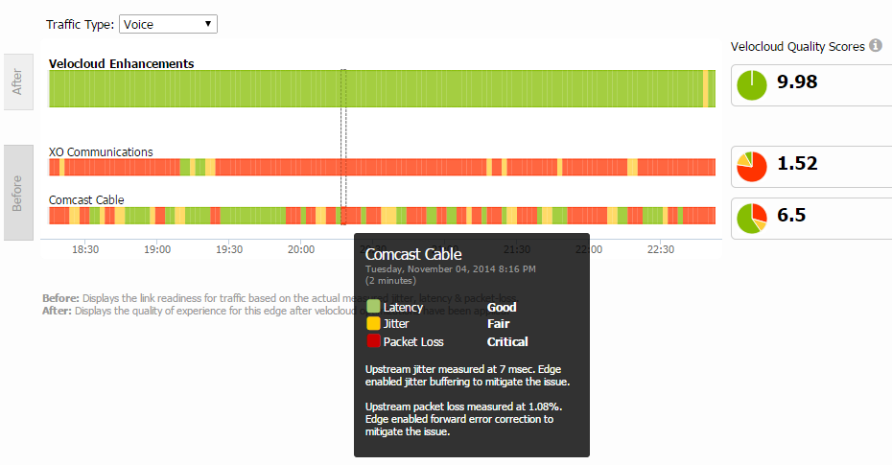
Dynamic Multi-Path Optimization
Assured Application performance over MPLS, Internet broadband and LTE circuits
Continuous Monitoring
Dynamic App Steering
On Demand Remediation
Automatic capacity testing
Continuous link & path quality monitoring
MPLS Class-of-Service aware
App aware per Packet Steering
Aggregated bandwidth for single flows
Dynamic link policy
Error & jitter correction
Automatic steering for brownouts/blackout
Enables single link performance
Error Correction
TCP Optimization
App Quality Score
Link Detection
Congestion Detection
Single or Multi- Link Acceleration
Application Performance Reporting
Notes:
This morning Sanjay mentioned the three key dimensions of our solution – the SDWAN overlay providing abstraction and automation, its availability as a cloud delivered service, and its role as a platform for delivering services.
We also have powerful architectures to deliver these capabilities for BOTH enterprise and service providers.
I will highlight our recent new and upcoming major features in all these dimensions.

Slide 13


Enhance User Experience
Video conference over a WAN link with 2% packet loss
Without Velocloud SD-WAN
With Velocloud SD-WAN
Notes:
This morning Sanjay mentioned the three key dimensions of our solution – the SDWAN overlay providing abstraction and automation, its availability as a cloud delivered service, and its role as a platform for delivering services.
We also have powerful architectures to deliver these capabilities for BOTH enterprise and service providers.
I will highlight our recent new and upcoming major features in all these dimensions.

Slide 14
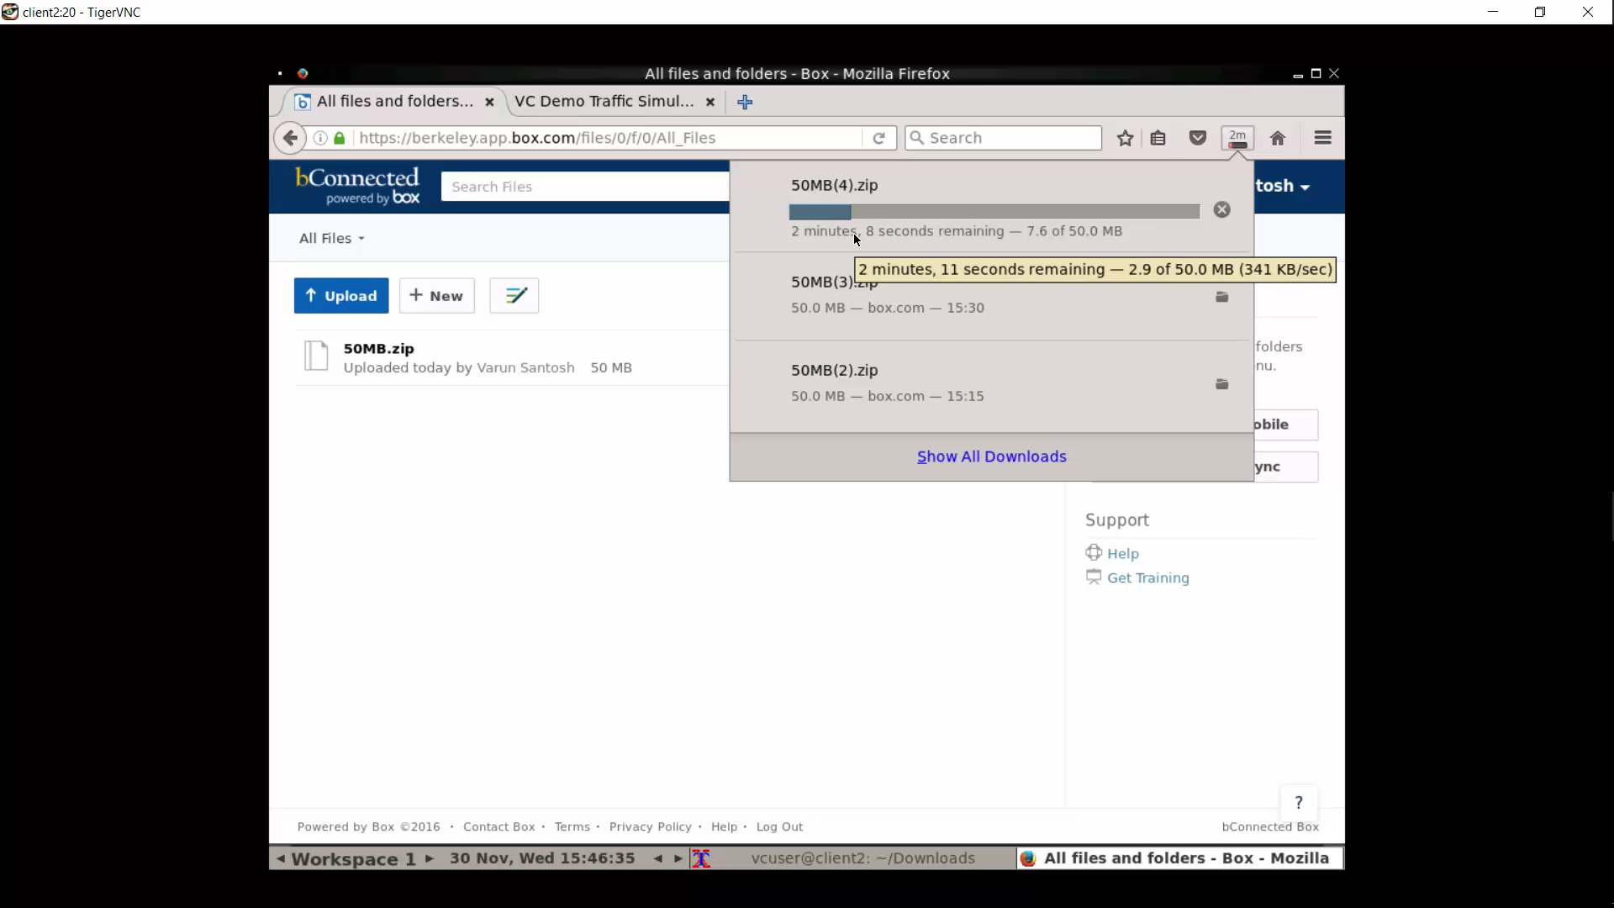
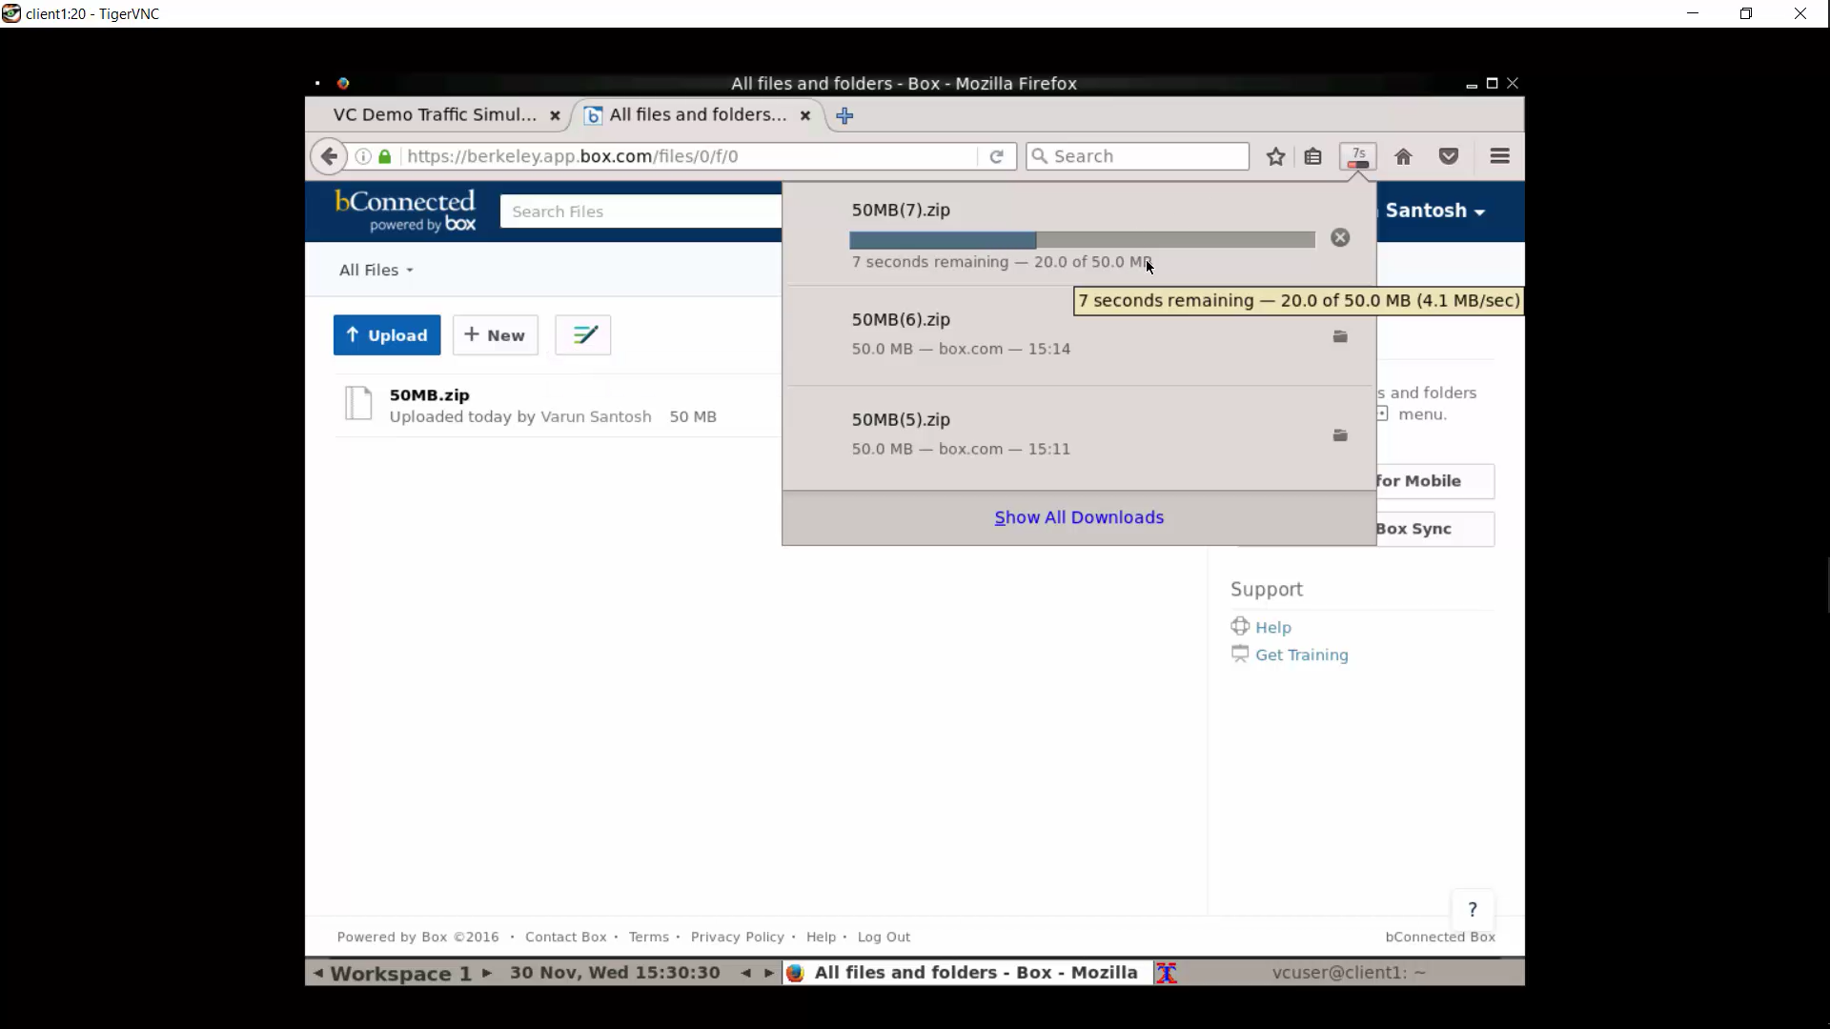
Link Bonding for TCP Applications
10x faster response time
Dual 20Mbps Links / 50 MB Box File Transfer
 | Without VeloCloud | VeloCloud
No Loss | 22 sec | 12 sec
2% Packet Loss | 134 sec | 13 sec
Notes:
One file transfer, 2x 20Mbps yet only one link is used
Velocloud: 2x 20Mbps links are used
Even with 2% packet loss, both links are used and forward error correction overcomes most of the packet loss

Slide 15
The VeloCloud Gateway

Slide 16
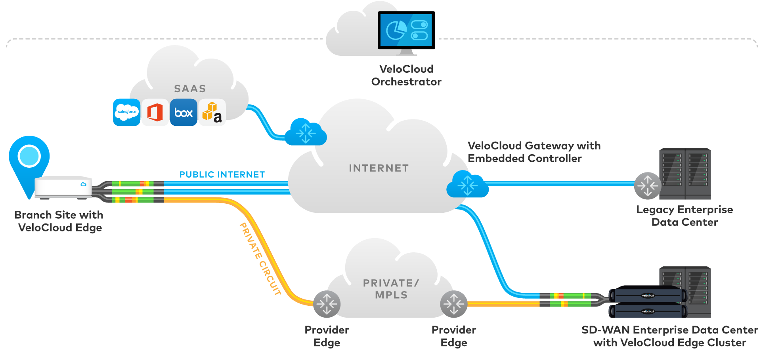

VeloCloud Hosted (Over the Top/OTT)
Hub for SD-WAN to data center including private links
VeloCloud Hosted gateways
for SD-WAN to SaaS/IaaS
Hub-less design for legacy data centers
“Site to site SD-WAN plus benefits of cloud gateways for SaaS”
SD-WAN
Overlay
Notes:
Our SD-WAN architecture for service providers uses multi-tenant Gateways deployed directly in providers datacenters and private networks.
This provides for all the benefits of SDWAN for the last mile, WITH the unique advantage of access to the private network for mid-mile as well as cloud access. What is the benefit?
Traffic at an offnet site, a hybrid site, a pop up retail site – can use an Internet connection for the local access or last mile
– yet hop onto the private network for midmile transport AND
Connect to all existing non-SDWAN sites
Edges can be deployed as appliances or as VNFs on a vCPE platform. I’ll cover additional upcoming virtualization features.
Our training over this conference will cover many features.
BGP and support for MPLS only sites enables the elimination of a separate CE router
COS, MPLS policing and tunnel shapers enable managed access to private network services

Slide 17
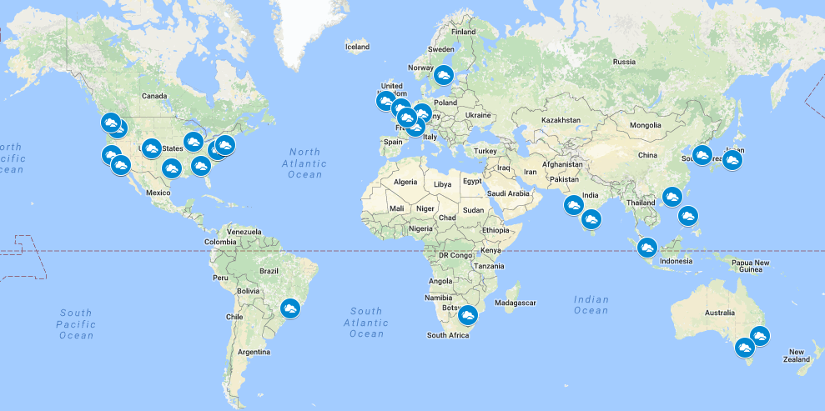
VeloCloud Gateway PoPs
Notes:
Our SD-WAN architecture for service providers uses multi-tenant Gateways deployed directly in providers datacenters and private networks.
This provides for all the benefits of SDWAN for the last mile, WITH the unique advantage of access to the private network for mid-mile as well as cloud access. What is the benefit?
Traffic at an offnet site, a hybrid site, a pop up retail site – can use an Internet connection for the local access or last mile
– yet hop onto the private network for midmile transport AND
Connect to all existing non-SDWAN sites
Edges can be deployed as appliances or as VNFs on a vCPE platform. I’ll cover additional upcoming virtualization features.
Our training over this conference will cover many features.
BGP and support for MPLS only sites enables the elimination of a separate CE router
COS, MPLS policing and tunnel shapers enable managed access to private network services

Slide 18




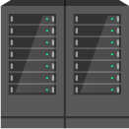












Service Provider Operated (SP)
SD-WAN for last mile/access
Access to private network for mid mile
Hub-less deployment in DCs and non-SD-WAN sites
Service Provider managed VeloCloud Orchestrator
“Complete Service Provider managed solution”
CE Router elimination
COS, MPLS policing, tunnel shaper
Per customer NAT (roadmap)
Service Provider Managed VeloCloud Gateways
Public Internet
Internet
Public Internet
Legacy Enterprise Data Center
Branch Site with VeloCloud Edge
Provider Cloud Data Center with Provider Gateways
Branch Site with VeloCloud Edge
Or
VeloCloud VNF
Private Circuit
SAAS
MPLS
VeloCloud “Partner Gateway” – Handoff to PE Router
PE Router
Provider Edge
Legacy Enterprise Data Center
PE Router
PE Router
Notes:
Our SD-WAN architecture for service providers uses multi-tenant Gateways deployed directly in providers datacenters and private networks.
This provides for all the benefits of SDWAN for the last mile, WITH the unique advantage of access to the private network for mid-mile as well as cloud access. What is the benefit?
Traffic at an offnet site, a hybrid site, a pop up retail site – can use an Internet connection for the local access or last mile
– yet hop onto the private network for midmile transport AND
Connect to all existing non-SDWAN sites
Edges can be deployed as appliances or as VNFs on a vCPE platform. I’ll cover additional upcoming virtualization features.
Our training over this conference will cover many features.
BGP and support for MPLS only sites enables the elimination of a separate CE router
COS, MPLS policing and tunnel shapers enable managed access to private network services

Slide 19
Security

Slide 20
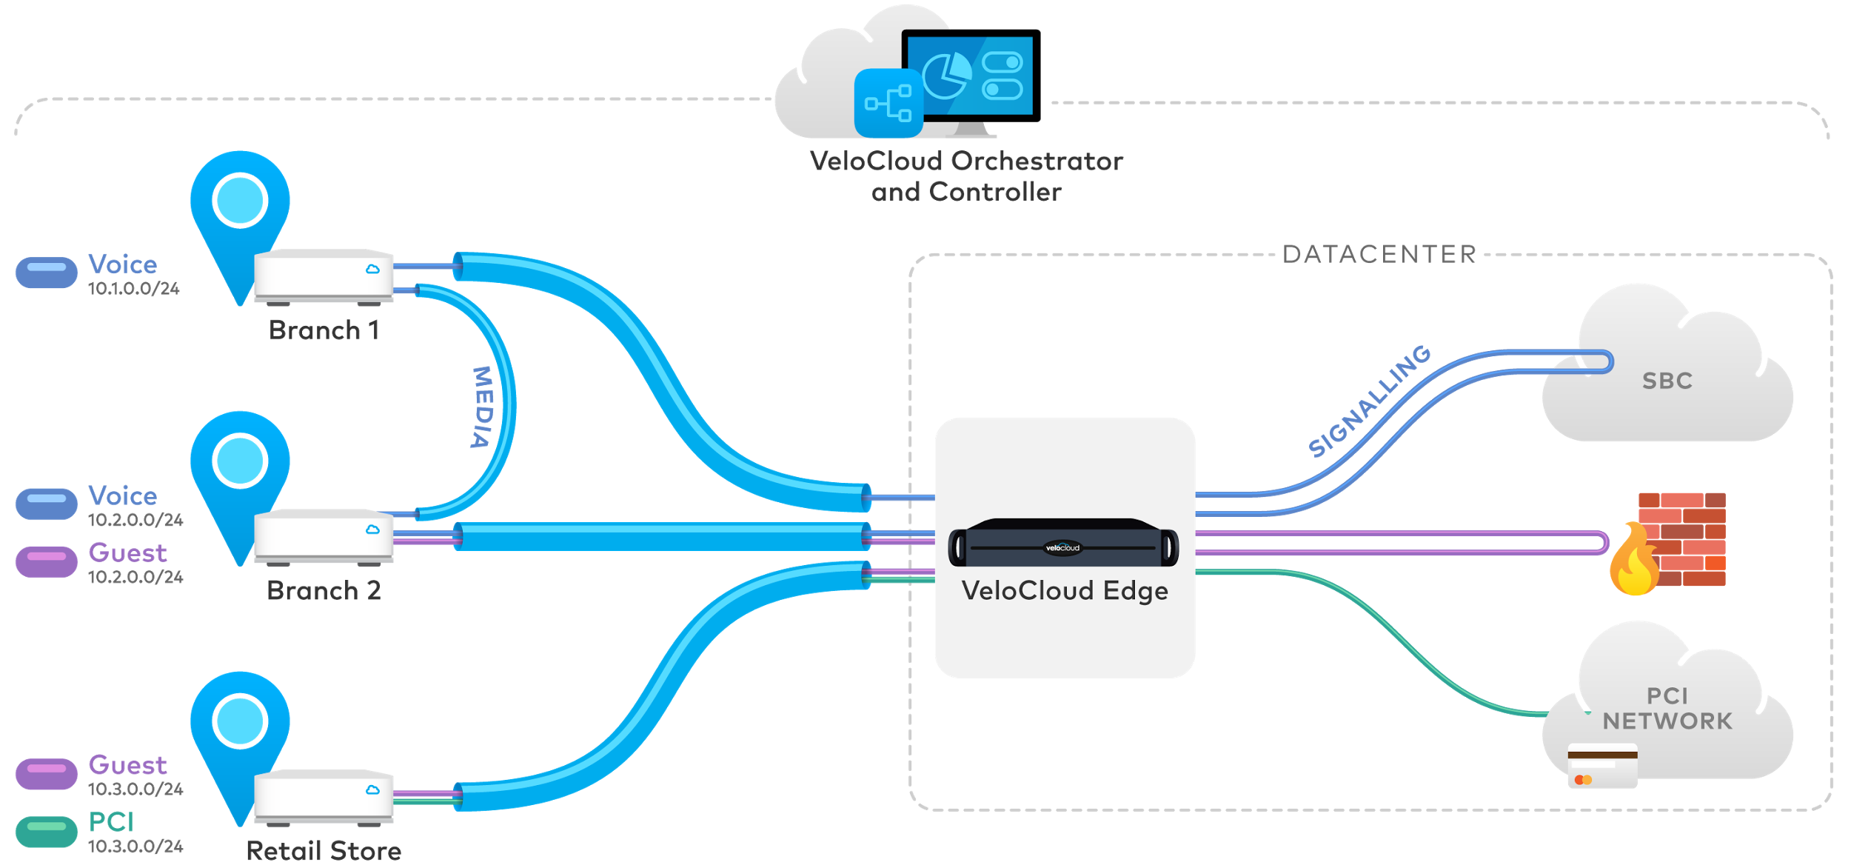
VeloCloud “Segmentation”: VPN Overlay VRFs
Enterprise Security Use Case
Simplification including global segment ID
Segment aware topology insertion
Overlapping IP in different segments
Notes:
One major new function currently in beta and to be RELEASED end of this month is segmentation.
This enables several use cases.
The first is for security in the enterprise.
Guest traffic can be segmented from corporate traffic, and PCI traffic further isolated.
Each segment can have own topology; ie dynamic B2B for voice, but backhaul guest internet traffic to central firewall
***Underlying this is multiple VRFs in a single Edge – you may see RFPs specifically calling out this capability
Segmentation is simplified with a global segment ID.
Neither complex firewall rules nor Ipsec tunnels per VLAN are required.

Slide 21





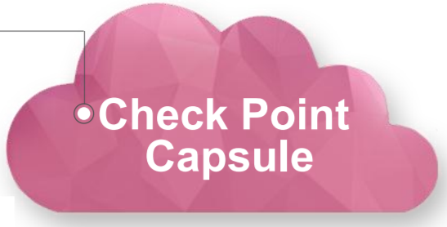


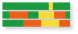


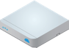
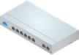
Cloud Security Integration
Cloud Security Service
VeloCloud Dynamic Multipath Optimization delivers application performance and reliability to cloud
Single-click Application-Aware Policies for granular service insertion
Non-Overlay IPSec (Future)
VeloCloud
Gateway
Corporate Datacenter
Automated tunneling eliminates site by site configurations
Branch Site
Dynamic Multi-Path Optimization
VeloCloud Edge
Dynamic Multi-Path Optimization
VeloCloud Edge Hub
Notes:
SECOND area for new functionality is our support of cloud security services.
This extends our capabilities AS A PLATFORM
Velocloud has provided our SDWAN directly to the doorstep of these services with our Gateways
These Gateways interconnected to partners such as Zscaler via Ipsec tunnels.
Support for this is extended to Forcepoint (Websense) as well as the NEW CHECKPOINT Cloud Capsule service.
[ firewall as well as web? ]
In 3Q, traffic can also be tunneled via Ipsec bypassing the Gateway. [ may be diff automation ]
This can provide connectivity for some geographies not yet served by a Gateway
And if cloud traffic ie web surfing only does not need reliability nor performance, without Premium Gateway services.

Slide 22
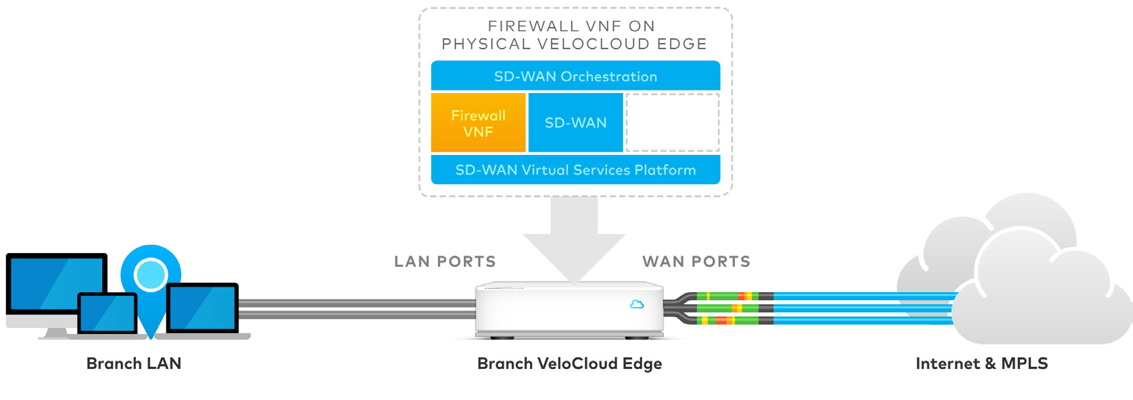
VeloCloud - Virtual Services Platform (Roadmap)
3rd-Party Firewall VNF on Edge
Virtual Ready (V) Edges
Notes:
The major extension of our capability AS A PLATFORM
Comes in the 2H of 2017
Velocloud SDWAN extends its Virtual Services Platform and Orchestration
To include the delivery of select third party partner VNFs
With our recent Security Ecosystem press release, we announced that CheckPoint, Fortinet and Palo Alto will be supporting their virtual firewalls on our upcoming platform.
These will be separately licensed from our partners
Virtual Ready versions of our Edges (540, 840) will have hardware support for these additional VNFs.
And our single Orchestrator platform will include the automated instantiation of these VNFs.
No other VNF or NFVi tools will be required.
The firewalls will be managed with the existing and same partner portals covering their physical appliances.
Our solution supports the most flexibility of choice, using our built-in network firewall or supporting the best of breed advanced threat firewalls from our partners.
** By having the SDWAN built-in and only supporting one additional VNF, we keep the Orch and Appliance simple and still cost effective.

Slide 23


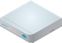

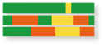
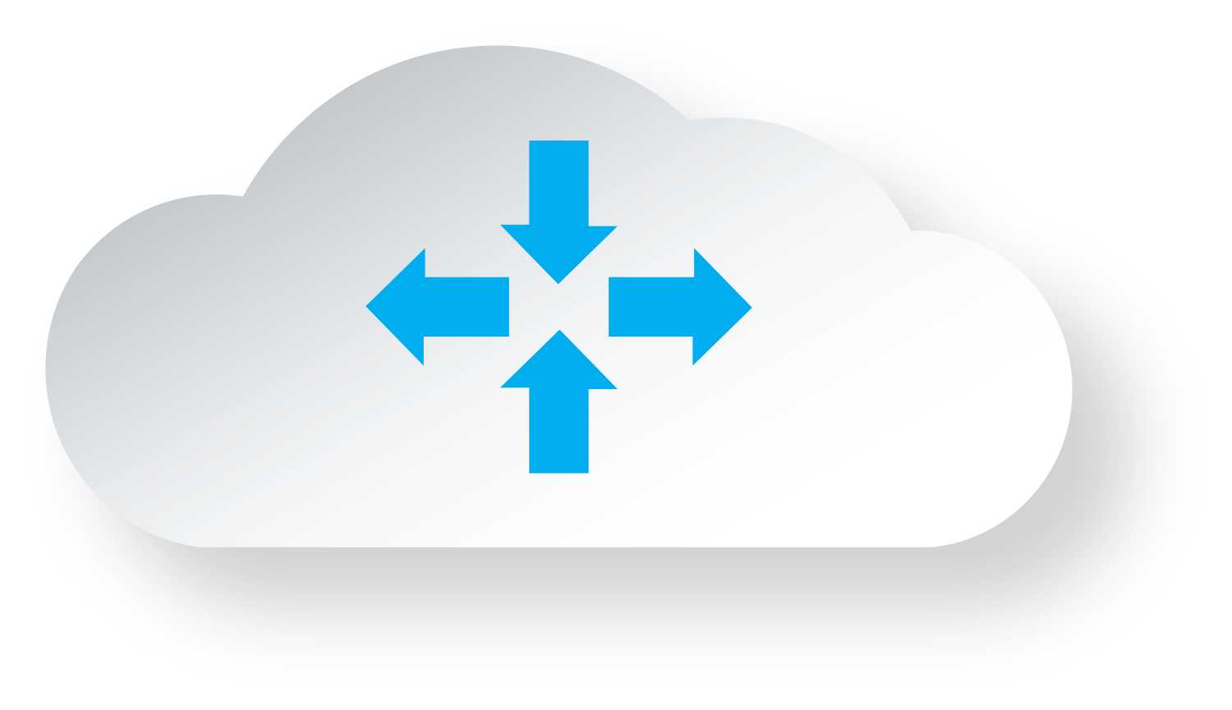

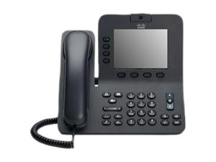
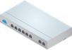


Dynamic Traffic Engineering
4
Non-critical Internet traffic, e.g. Netflix
3
Critical Internet traffic, e.g. SaaS
Branch Edge
1
Internet/MPLS
VCG
www
Branch Edge
Hub Edge
2
Backhaul certain traffic to hub first, e.g. other Web browsing
Dynamic branch to branch tunnel
Notes:
This morning Sanjay mentioned the three key dimensions of our solution – the SDWAN overlay providing abstraction and automation, its availability as a cloud delivered service, and its role as a platform for delivering services.
We also have powerful architectures to deliver these capabilities for BOTH enterprise and service providers.
I will highlight our recent new and upcoming major features in all these dimensions.

Slide 24
Hardware Appliances

Slide 25
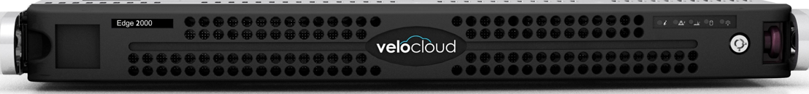
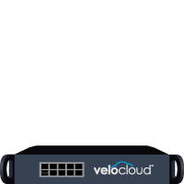
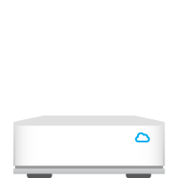
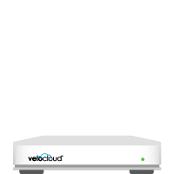
High Performance Networking
100 Mbps
400 Mbps
1 Gbps
5 Gbps
Multi-Gigabit
Edge 510
Edge 520
Edge 540
Edge 840
Edge 2000
Edge Cluster
4-Port GE
2-USB—LTE WiFi
10-Port GE
2-Port SFP
4-USB—LTE WiFi
10-Port GE
2-Port SFP
4-USB—LTE WiFi
6-Port GE
2-Port SFP+
6-Port GE
2-Port SFP+
Notes:
Switching gears back to our standard platform portfolio.
This month we are adding support for the release of two new platforms
Extending the low end with the 510, and the high end with the Edge 2000
The 510 provides more economical support of the lower throughputs such as 30 and 50M.
It also has capability for built-in LTE support – stay tuned on this front
The Edge 2000 will support support 1G as well as extend to 2G initially. And we have plans for a 5G single appliance, targeting the same Edge2000 hardware.
Our multi-gigabit cluster capability for datacenters, including for Virtual Edges
Is in deployment at several large ent and scales to many 10s of Gigabits.

Slide 26
Edge Models and Throughput License Supported
 | Aggregate WAN Throughput
Platforms ↓ | 30 Mbps | 50 Mbps | 100 Mbps | 200 Mbps | 400 Mbps | 1 Gbps |  | 2 Gbps | 5 Gbps
Edge 510
Edge 520
Edge 540
Edge 840
Edge 2000
Virtual Edge
 | Supported Throughput License

Slide 27
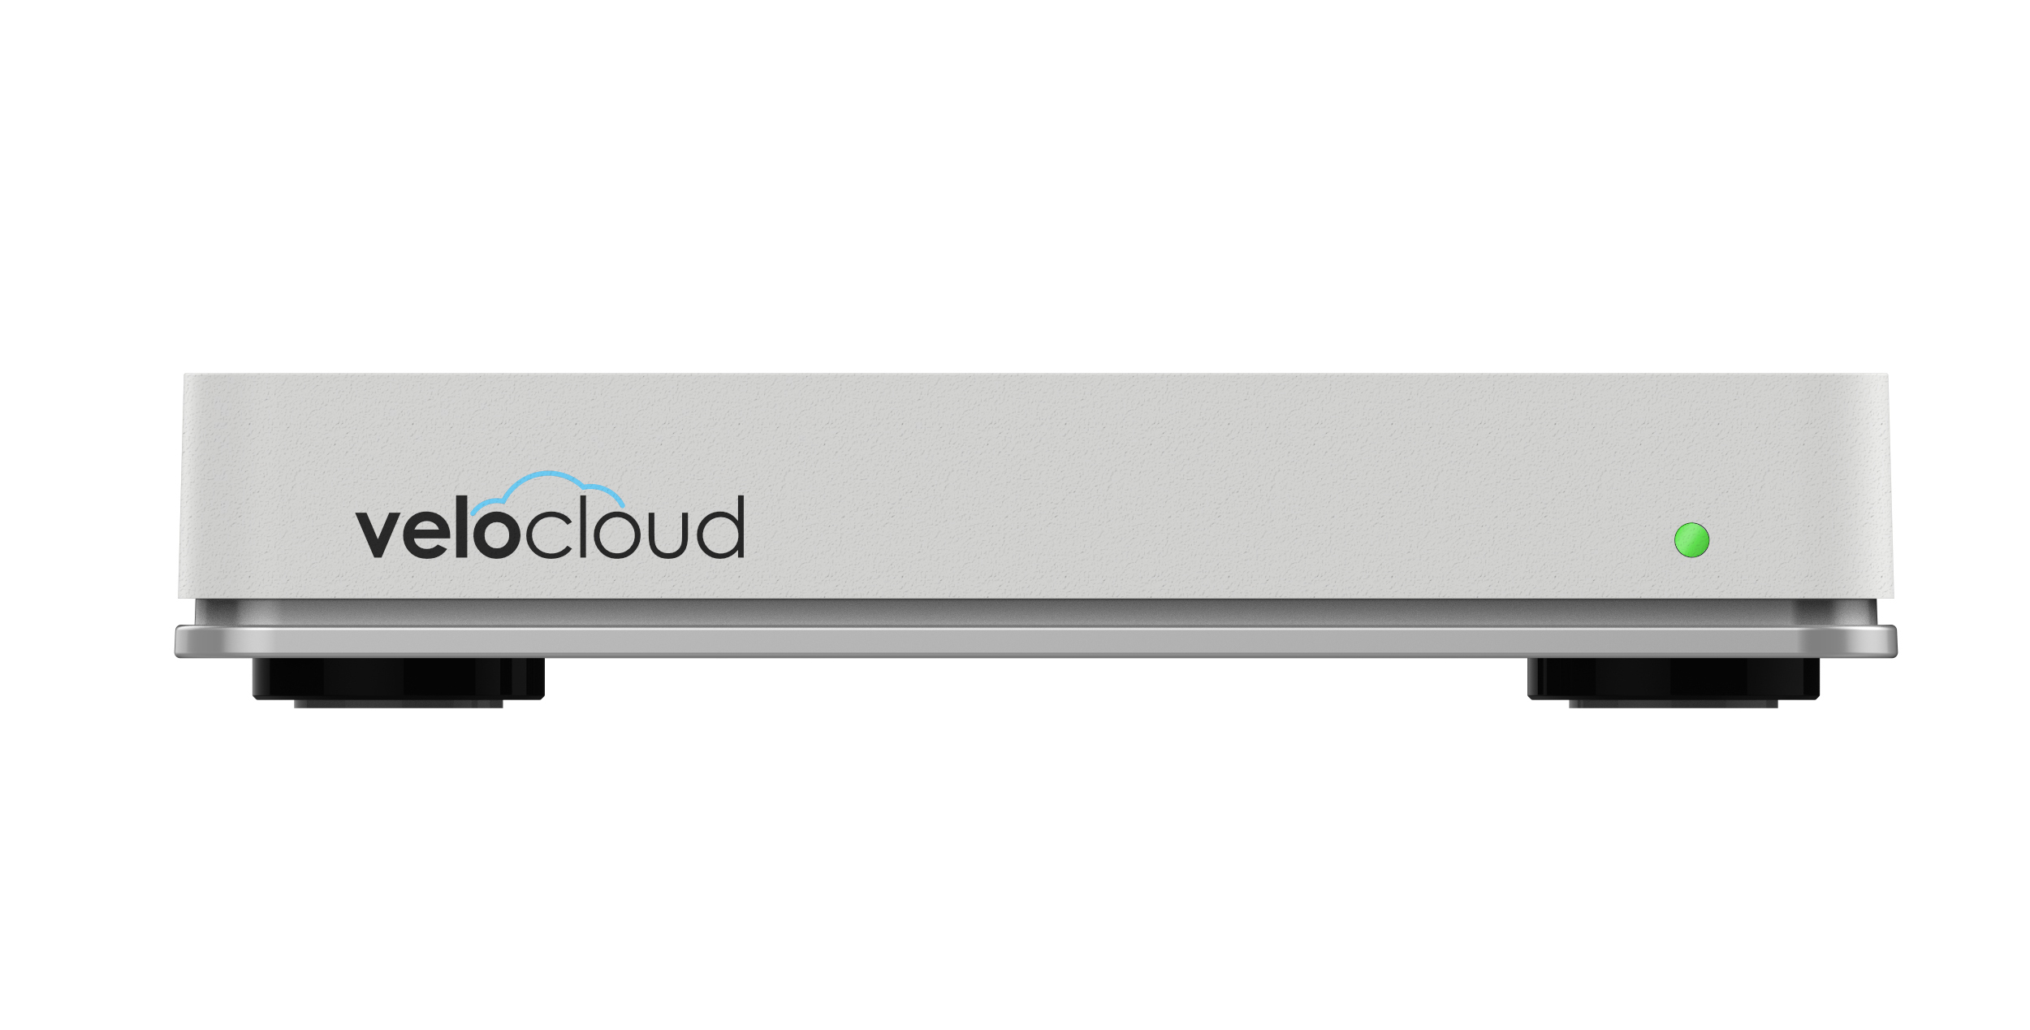
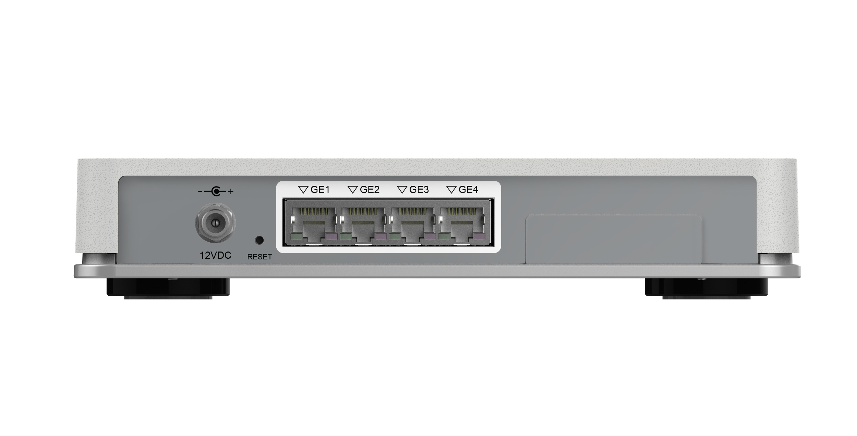
Edge 510
Wireless LAN 2.4GHz or 5GHz
1
`
Wireless WAN Connections (USB)
2
USB1
USB2
Power Connection
Wired LAN or WAN
4
3

Slide 28
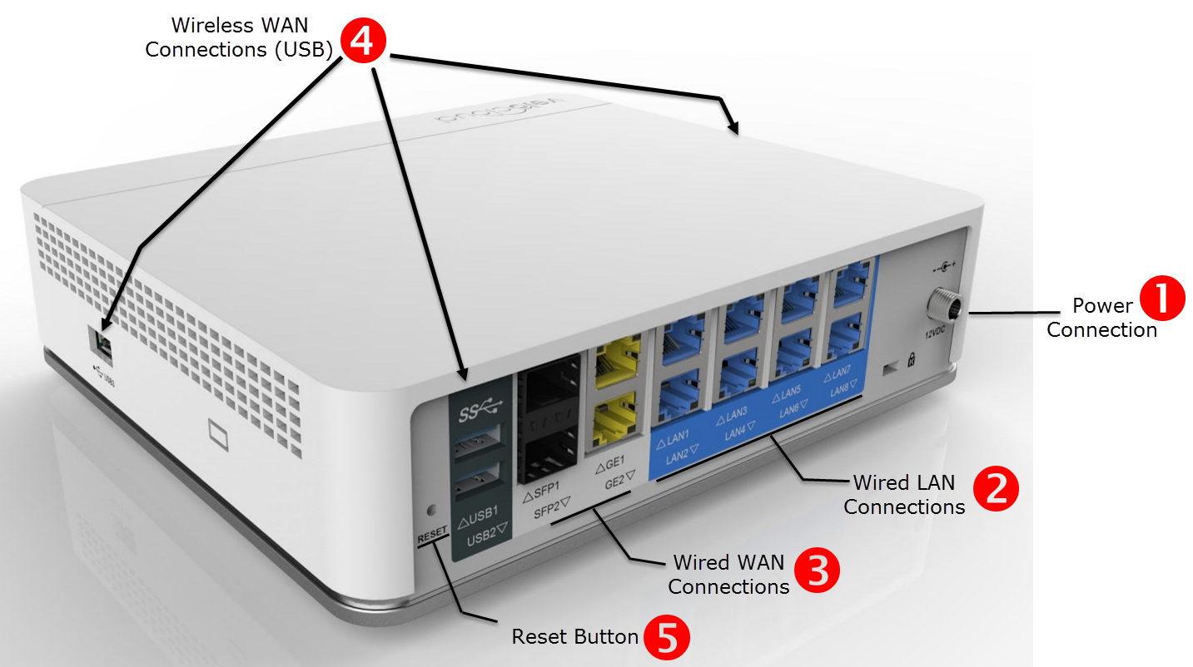
Edge 520 and 540
Notes:
Wired WAN Connections – Provides two Ethernet and two SFP connections for up to four WAN connections.
Service Indicator – Displays the status of the WAN connection and VeloCloud service. The light has the following status colors:
• Red – There is no active WAN connection.
• Yellow – There is an Internet connection, but the device has not been activated, or the VeloCloud service is not active.
• Green – The device has been activated, and the VeloCloud service is active.
• Blue – The device is a functioning standby in a High Availability (HA) configuration.
The Service Indicator is also used to indicate some system functions in progress:
• White – Initial power-on and boot sequence.
• Flashing blue – A system reset or a software update is in progress.
• Flashing white – Identifies a function invoked from VeloCloud Orchestrator.
• Flashing red – The device has detected a hardware failure.

Slide 29
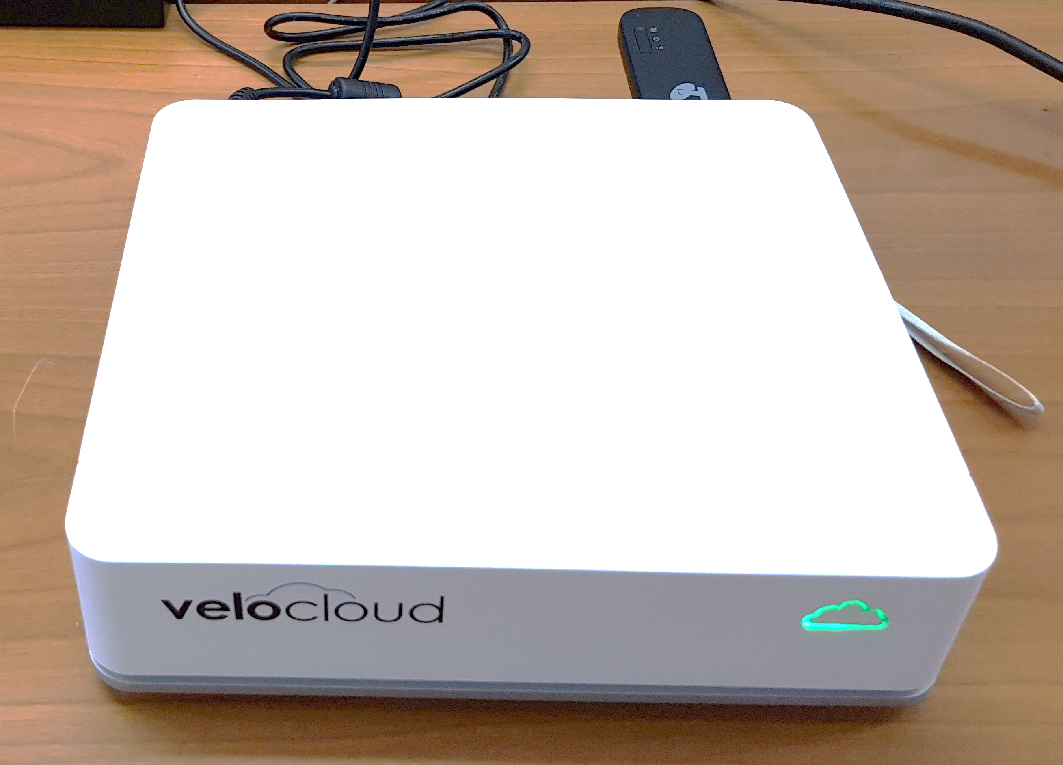
Edge 520 with 4GX Dongle

Slide 30
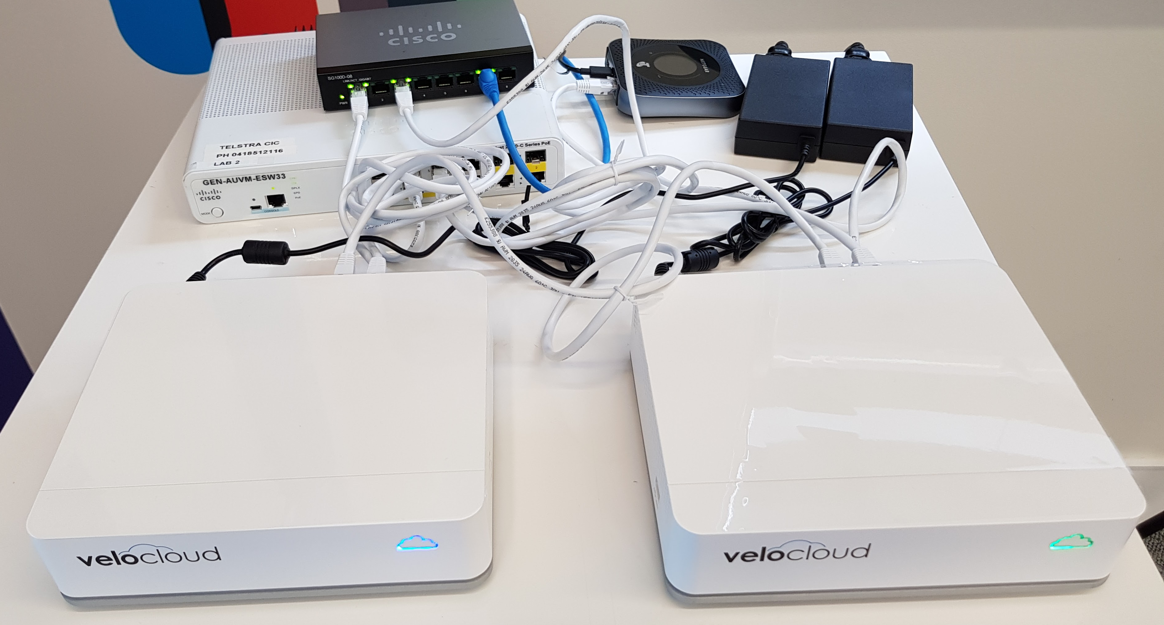
HA Example – 2x Edge 540

Slide 31




SD-WAN Virtual Services Delivery
Velocloud Edge with 3rd Party VNF
Whitebox CPE with Velocloud VNF
SDWAN Orchestration
NFV Orchestration
Other
VNFs
SDWAN
VNF
FW
VNF
X
VNF
SDWAN
FW VNF
vCPE platform
…others
…others
Notes:
In addition to forwarding or backhauling traffic for service insertion, SDWAN can support virtual services delivery.
In the middle, is an example of the VeloCloud approach
To offer NFV capabilities tied in with its SDWAN solution.
For a selected set of network services most relevant for branch deployments eg firewalls
But to target an open non-competing platform that enables best of breed partners.
Orchestration would provide the instantiation and initial config of the third party VNF, as well as management of the platform resources.
And on the right is an example of general purpose NFV platforms, now being packaged for the market by providers as virtual CPEs
That can offer best of breed choices for all services including the SD-WAN service. SDWAN solutions need to provide the APIs for integration into the orchestration platforms.
.

Slide 32
Scoping and Sizing

Slide 33
Identify Success Criteria
Decrease usage of or remove costly Private links / MPLS
Controlled Local Internet breakout for Bulk Internet e.g. Youtube
Delivering VOIP over the Internet
Link bonding e.g. MPLS + Internet
4G Backup by policy
Cloud Content filtering via Policy e.g. zScaler
Overlapping address space due to acquisitions
Simplify the WAN config – no CLI!

Slide 34
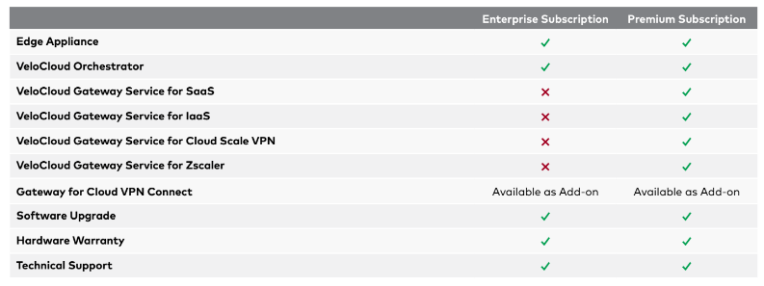
Subscription Offerings

Slide 35
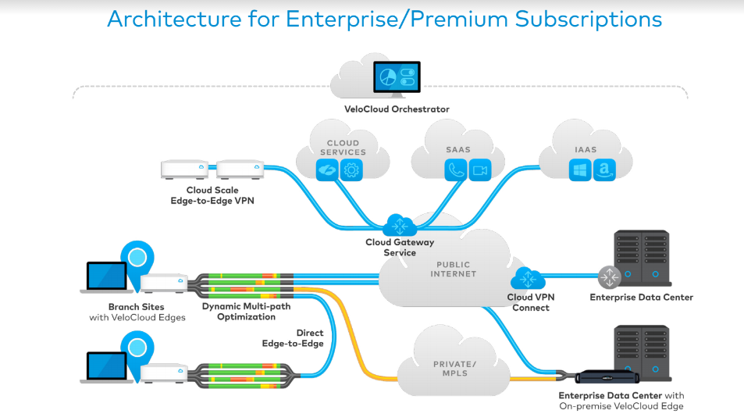
Enterprise Subscription
Enterprise Subscription:
One site Edge
By size
VCO for one site

Slide 36
Premium Subscription
Premium
Subscription:
One site Edge
By size
VCO for one site
Plus use of multiple Gateways

Slide 37
Cloud VPN Connect Subscription
Cloud VPN Connect
Subscription:
One legacy DC
By size
VCO

Slide 38
Edge Models and Throughput License Supported
 | Aggregate WAN Throughput
Platforms ↓ | 30 Mbps | 50 Mbps | 100 Mbps | 200 Mbps | 400 Mbps | 1 Gbps |  | 2 Gbps | 5 Gbps
Edge 510
Edge 520
Edge 540
Edge 840
Edge 2000
Virtual Edge
 | Supported Throughput License

Slide 39
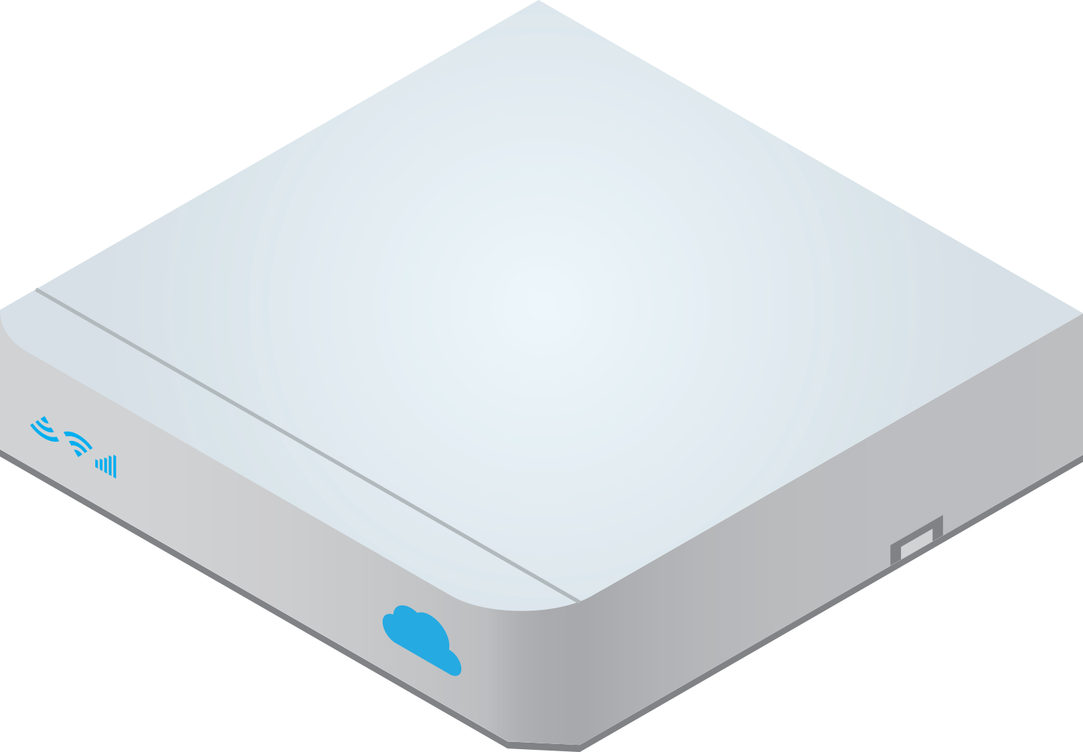
Definition of WAN Aggregate Throughput
Example 1: Single WAN circuit
Example 2: Dual WAN circuits
WAN Interfaces
10Mbps upstream
Dynamic Multipath
10Mbps upstream
15Mbps downstream
VPN
8Mbps upstream
15Mbps downstream
10Mbps downstream
15 + 10 = 25Mbps WAN throughput
Recommend 30Mbps Tier
Direct to Internet
15 + 10 + 10 + 8 = 43Mbps
WAN throughput
Recommend 50Mbps Tier, but lower tier may be chosen
Any mix of services including 100% encryption and Dynamic Multipath. Throughput tier includes ALL traffic processed by Edge
Customer may chose to underprovision
to 30 Mbps

Slide 40
VeloCloud Edge Quick Sizing Tool
Example | Customer Type | Branches | DC/Head Office (sites with Application Servers) | SaaS / IaaS apps?
1 | Small / Internet Only / Not much on-prem IT | 20 | 1 | Yes - 100%
2 | Medium / MPLS + Internet / 50% in the cloud | 50 | 2 | Yes - 50%
3 | Large / Old-School IT shop | 200 | 2 | Not yet

Slide 41
Sizing FAQ
Is standby Counted ?
Is Zscaler included in Premium license ?
Am I allowed to underprovision ?
How is throughput calculated ?
Are the tunnels mapped to Platform or Subscription tier ?
Can I order a specific platform for a subscription tier ?
What is maximum throughput tier I can order today ?
Virtual Edge throughput and supported IO ?

Slide 42
PoC Best Practise
Keep it Simple – Two Edges is enough in most cases!
Keep it Short – Limit the PoC to 4 weeks and set a clear end date
Define the Success Criteria
Define a Schedule
Most Important: Assuming PoC is Successful, What’s your Budget for SDWAN?

Slide 43
PoC Schedule
Sn. | Task | Owner | Remarks
1 | Detail topology diagram of existing network both at Hub and Branches locations | <Customer>
2 | PoC Architecture: VCE insertion plan at hub location VCE insertion plan at branch location | VeloCloud/<Customer> | Pending/Completed
3 | Provision account on VCO | VeloCloud
4 | Pre-Configure VeloCloud edge on VCO for Hub location as per information provided | VeloCloud
5 | Physical Installation and Activate Hub Edge | VeloCloud/<Customer>
6 | Pre-Configure VeloCloud edges on VCO forvBranch locations as per Information provided | VeloCloud
7 | Physical Installation and Activate branch edges | VeloCloud/<Customer>
8 | Order of installation at Branch locations

Slide 44
Success Criteria Exmple
Success Criteria | Met? (Yes/No)
1.) Full production cutover Traffic flowing smoothly to all sites
2.) Connectivity to SD-WAN and Non SD-WAN sites Successful communication of SD-WAN and Non-SD-WAN locations
3.) Successful Integration & utilization of zScaler
4.) Blackout/brownout protection with no impact to application eg: ERP traffic
5.) WAN visibility through VeloCloud Orchestrator
6.) Hybrid aggregation Aggregation of MPLS and Internet connectivity Sub-second packet steering

Slide 46
Use Case: Retail

Slide 47
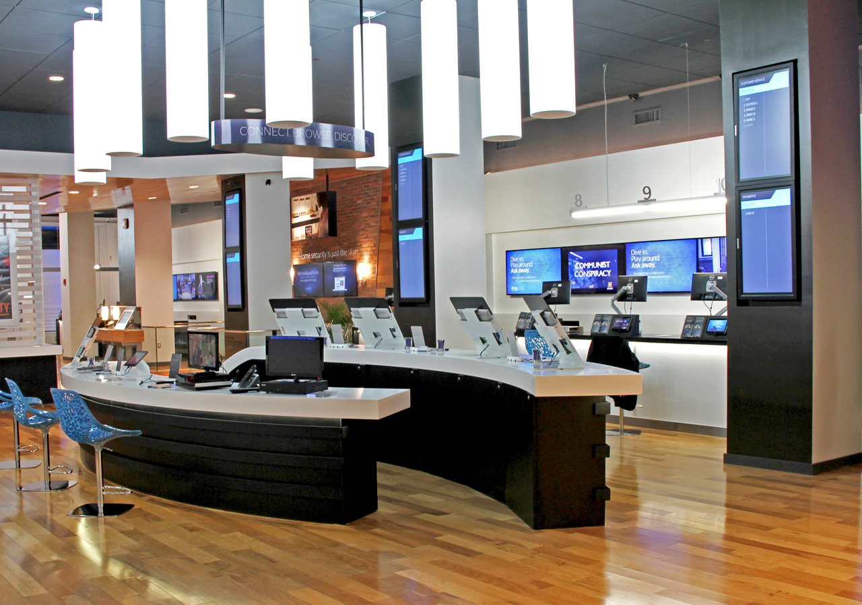

Retail – Next-Generation Store Experience
Infinite Inventory
Couponing, Loyalty, CRM
Virtual Assistant
Guest Wi-Fi Internet
Video Training
Digital Signage, & Kiosks
Tablets & Smart Devices
Mobile & Web Point-of-Sale
Virtual Desktop
Digital Catalogues
Notes:
This morning Sanjay mentioned the three key dimensions of our solution – the SDWAN overlay providing abstraction and automation, its availability as a cloud delivered service, and its role as a platform for delivering services.
We also have powerful architectures to deliver these capabilities for BOTH enterprise and service providers.
I will highlight our recent new and upcoming major features in all these dimensions.

Slide 48








Retail Store - WAN Is The Bottleneck
Digital Signage
Guest Internet
Mobile Checkout
Virtual Assistant
Virtual Desktops
Mobile Kiosks
Unified Comm
Retail CRM
Retail POS Network
Signage Servers
Retail Databases
Presence Apps
Loyalty Apps
Couponing Apps
Internet
Backhaul of Internet
4G-LTE
Private—MPLS
Corp Datacenter
Store
Internet - DSL, Cable, Fiber
Cloud Services Reducing Visibility, Control & Security
Retail Stores Demand for 10X+ Bandwidth
Corporate IT Lacks Staff in Retail Branch Stores
Internet Lacks Reliability, Performance & Quality
Traditional Wide Area Networking Is Expensive
Lean Store Demands Less Equipment & Less Complexity

Slide 50
Backup Slides

Slide 51


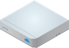




VeloCloud Deployment Options
Dual L3 switches
Data Center Headend
Velocloud Edges in HA Pair or Cluster
Single L2/L3 switch
DC Core
CE Elimination
MPLS with VPN backup
Single/dual Internet

Slide 52
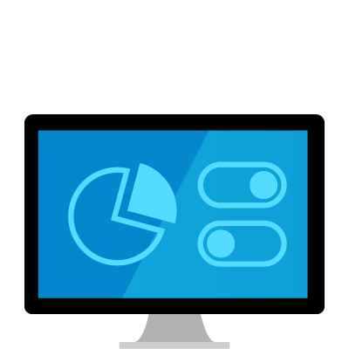

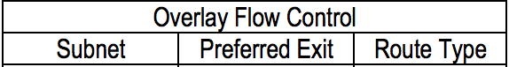
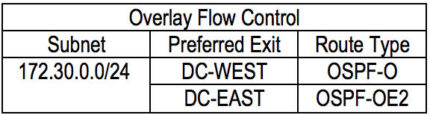
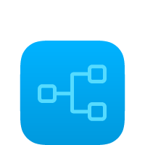



SDWAN Routing Control
VeloCloud Orchestrator
Bronze Site
Single/dual Internet
VeloCloud Edge
VeloCloud Controller (Function of Gateway)
SD-WAN Programmability
Route Learning
VeloCloud Edge
VeloCloud Hub Edge
Silver Site
Single L2/L3 switch
OSPF or BGP
VeloCloud
DC-WEST
OSPF or BGP
With or without CE router
172.30.0.0/24
Legacy Site
MPLS with VPN backup
VeloCloud
DC-EAST
VeloCloud Hub Edge
“SD-WAN Route programing with Enterprise wide View and Control”
Routing (BGP or OSPF) enabled on multiple sites
Enterprise wide route visibility & control
One-click full or partial overlay programming

Slide 53
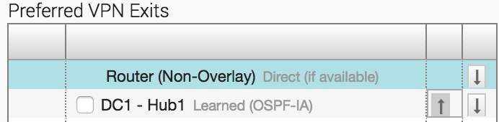
Example: Offload Legacy Site Traffic to MPLS
Without VeloCloud: Per branch, manually configure L3 switch CLI with prefix list, route map and static routes…
VeloCloud OFC: “One-click” control path preference and automatically apply to all branches
DC1-Hub1
VeloCloud Controller
HUB
1
By default, send to overlay
172.28.0.0/24
Legacy Site
Edge
1
Overlay Traffic
2
Update L3 switch to send Legacy Site traffic through
MPLS and other traffic still send to overlay
2
Offload traffic
Silver Branch Site
172.28.0.1

Slide 54

Datacenter Scalability
NEW
(Unique private and public IP Address per Hub)
The Controller load balances tunnels from the branch edges to the hubs within the cluster
Hubs report usage to the VCC periodically
In case of a hub failure, the VCC re-balances the tunnels to remaining active hubs in the cluster
Hub Cluster
L3 Switch
L2 Switch
FW
CE Router
Controller
(VCG Function)
Data plane session from Branch VCE to Hub cluster over MPLS / Internet
Control plane session from Branch and Hub VCEs to the Controller
Branch Edges
Notes:
For datacenter installations of SDWAN, hubs can scale via clusters
These clusters are load balanced by a controller not in the data plane, so there is no single SDWAN appliance or VM limiting scalability.
The controller load balances tunnels from branch Edges to hubs within the cluster
In addition to scaling, this provides very cost effective N+1 redundancy
The controller simply rebalances tunnels to the remaining active hubs in the cluster.
Each hub maintains BGP neighborship with the L3 switch.

